Slide 1
Miscellaneous problems
At university cafeteria, on the average 1.5 customers arrive per minute. Find the probabilities that:
(a) at most 4 will arrive in a given minute.
(b) at least 3 will arrive during an interval of 2 minutes.
(c) exactly 15 will arrive during an interval of 6 minutes.
Notes:
P(X<=4) = 0.9814 (b) P(X>=3) = 0.5768, mean=3
(c) P(X=15) = 0.0194, mean=(1.5)*(6)=9

Slide 2
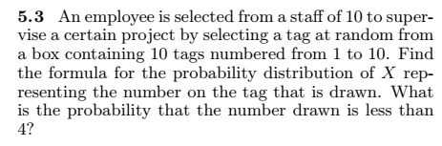

Miscellaneous problems (contd.)
Notes:
(5.3) f(x) = 1/10; P(X<4) = 3/10
(5.12) P(X<4) = 0.8343

Slide 3
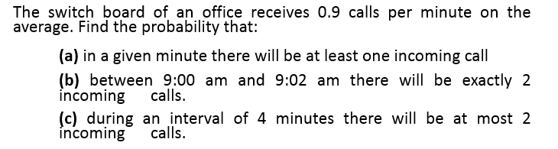
Miscellaneous problems (contd.)
Notes:
(3) N>27
(4) (a) P(X>=1) = 0.593 (b) P(X=2) = 0.2677 (c) P(X<=2) = 0.3027

Slide 4
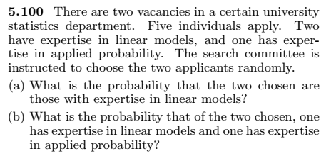
Miscellaneous problems (contd.)
Notes:
(a) 0.1 (b) 0.2 (more than two categories → multivariate hypergeometric)

Slide 5
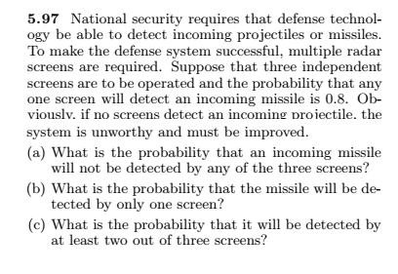
Miscellaneous problems (contd.)
Notes:
0.008 =P(X=0)
3C1(0.8)(0.2)^2= 0.096
P(X>=2) = 0.896

Slide 6
Miscellaneous problems (contd.)
A coin is biased with probability of a head 2/3. Find the probability that a head appears on the 5th trial.
End of Mid – II Syllabus
Notes:
2/243 = 0.008230

Slide 8
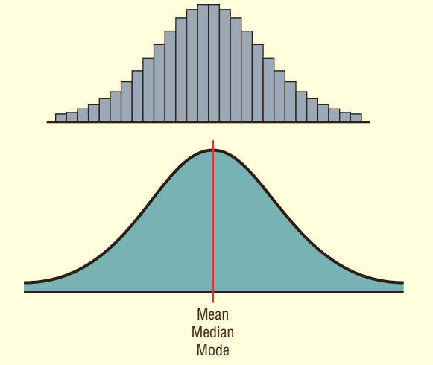
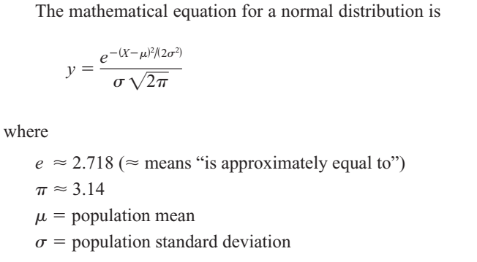
Normal / Gaussian Distribution
PDF of Normal Distribution

Slide 9
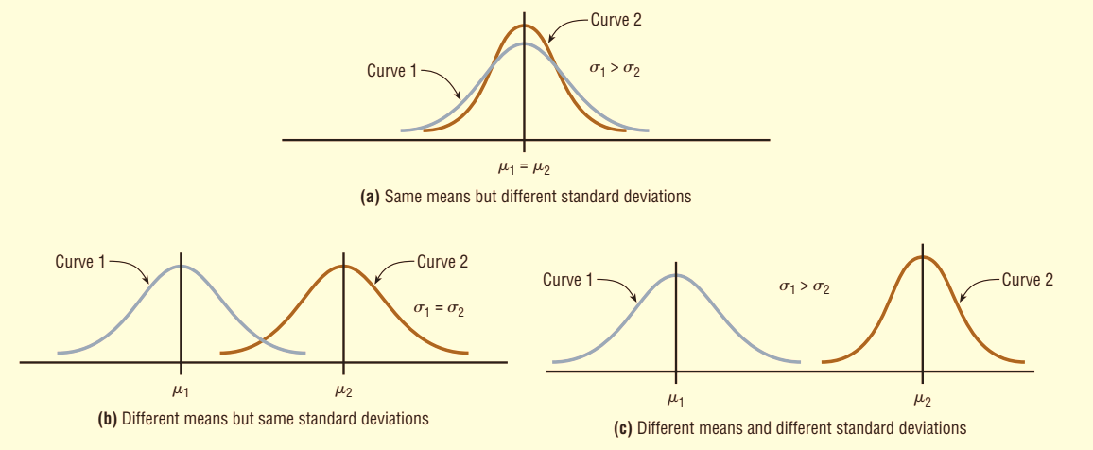
Shapes of Normal Distribution

Slide 10
Properties of Normal Distribution
A normal distribution is bell-shaped, symmetric and unimodal.
Mean = Median = Mode
The curve never touches the x axis but it gets increasingly closer.
The total area under a normal distribution curve is equal to 1.00, or 100%.
The area under the part of a normal curve that lies within 1 standard deviation of the mean is approximately 0.68, or 68%; within 2 standard deviations, about 0.95, or 95%; and within 3 standard deviations, about 0.997, or 99.7%.

Slide 11


The Standard Normal Distribution
The standard normal distribution is a normal distribution with a mean of 0 and a standard deviation of 1.
The formula for the standard normal distribution is:
All normally distributed variables can be transformed into the standard normally distributed variable by using the formula for the standard score:
Notes:
The z score is actually the number of standard deviations that a particular X value is away from the mean.

Slide 12
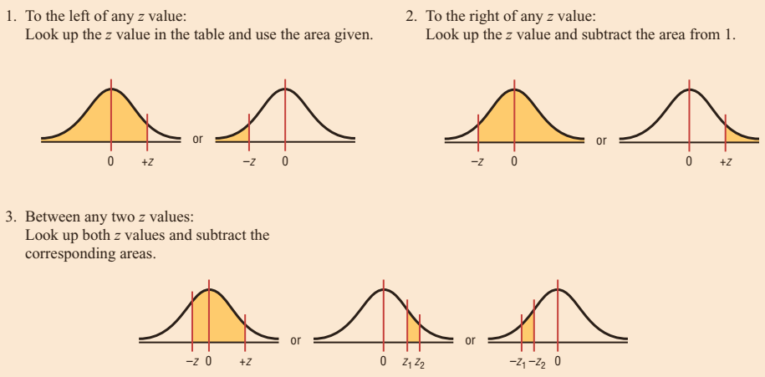
Areas under the standard Normal Curve

Slide 13

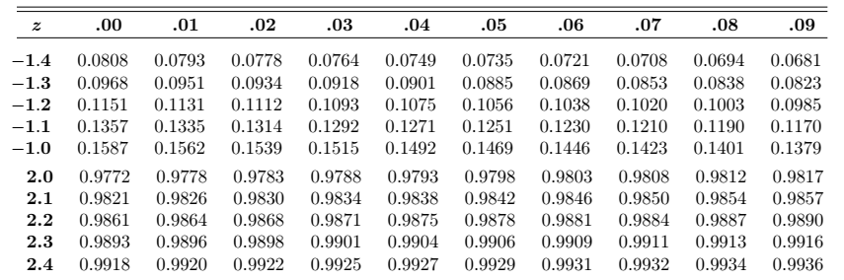
Example 01
Find the area to the left of z = 2.06
Find the area to the right of z = -1.19
Find the area between z = 1.68 and z = -1.37
Notes:
Incomplete Standard Normal table
P(z>-1.19) = 1 – 0.1170 = 0.8830
P(-1.37< z < 1.68) = 0.9535 – 0.0853 = 0.8682
The area under the standard normal distribution curve can also be thought of as a probability.

Slide 14
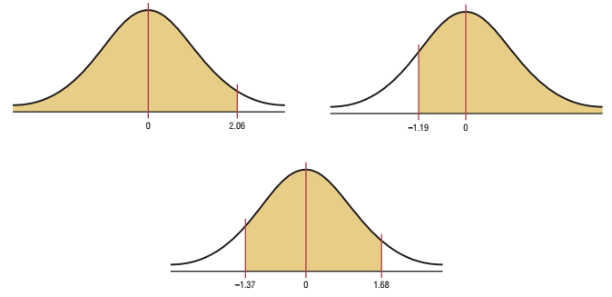
Example 01 (Contd.)

Slide 15
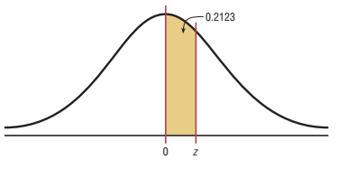
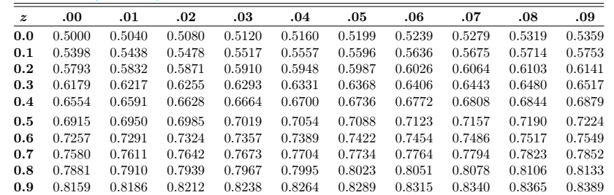
Example # 02
Find the z value such that the area under
the standard normal distribution curve b/w
0 and the z value is 0.2123.
Notes:
it is necessary to add 0.5000 to the given area of 0.2123 to get the cumulative area of 0.7123.

Slide 16
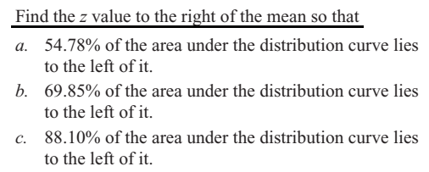
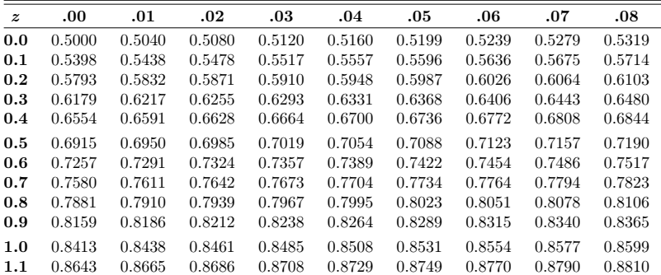
Example # 03:
Notes:
(a) 0.12 (b) 0.52 (c) 1.18

Slide 17
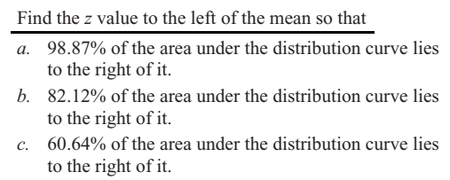
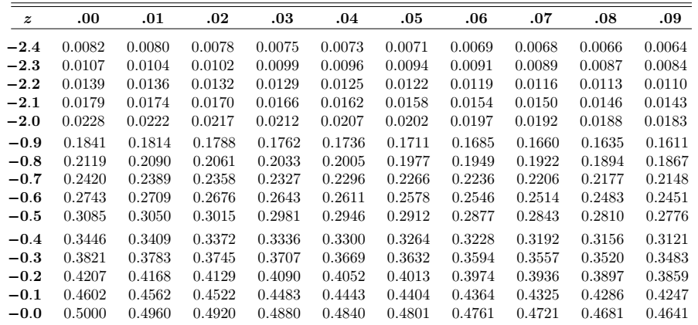
Example # 04:
Notes:
(a) 1 – 0.9887 = 0.0013 (z=-2.28) (b) 1 – 0.8212 = 0.1788 (z=-0.92) (c) 1 – 0.6064 = 0.3936 (z= -0.27)

Slide 18
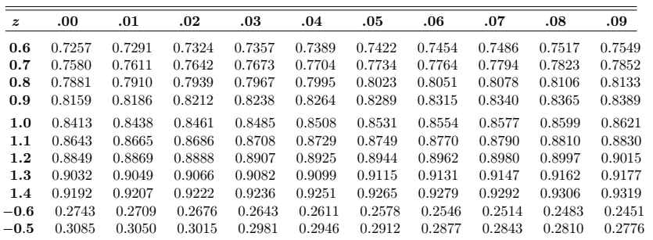
Example # 05
In the standard normal distribution, find the values of z for the 75th, 80th, and 92nd percentiles.

Slide 19
Example # 06 – 07
Summer Spending: A survey found that women spend on average $146.21 on beauty products during the summer months. Assume the standard deviation is $29.44. Find the percentage of women who spend less than $160.00. Assume the variable is normally.
Monthly Newspaper Recycling: Each month, an American household generates an average of 28 pounds of newspaper for garbage or recycling. Assume the standard deviation is 2 pounds. If a household is selected at random, find the probability of its generating:
a. Between 27 and 31 pounds per month b. More than 30.2 pounds per month
Notes:
Z = 0.47 (0.6808)
(a) Z = -0.6 & 1.5 → 0.6247

Slide 20
Example # 08 – 10
Coffee Consumption: Americans consume an average of 1.64 cups of coffee per day. Assume the variable is approximately normally distributed with a standard deviation of 0.24 cup. If 500 individuals are selected, approximately how many will drink less than 1 cup of coffee per day?
Police Academy Qualifications: To qualify for a police academy, candidates must score in the top 10% on a general abilities test. The test has a mean of 200 and a standard deviation of 20. Find the lowest possible score to qualify. Assume the test scores are normally distributed
Find K: Given a standard normal distribution, find the value of k such that (a) P (Z > k) = 0.3015 and (b) P (k < Z < -0.18) = 0.4197.
Notes:
(8) Z = -2.67 (500* 0.0038=1.9)
[9] the test value X that cuts off the upper 10% of the area under a normal distribution curve is desired (1 – 0.1000 = 0.9000) → Z=1.28 (X = 226)
K=-0.52 & for (b) k = -2.37 (find all area below z=-0.18=0.4286)→0.4286-0.4197=0.0089

Slide 21
Example # 11
In an industrial process, the diameter of a ball bearing is an important measurement. The buyer sets specifications for the diameter to be 3.0 ± 0.01 cm. The implication is that no part falling outside these specifications will be accepted. It is known that in the process the diameter of a ball bearing has a normal distribution with mean μ = 3.0 and standard deviation σ = 0.005. On average, how many manufactured ball bearings will be scrapped?
Notes:
(2.99 < x < 3.01)=P(-2.0 < z < 2.0) Now [P(Z < -2.0) + P(Z > 2.0) = 2(0.0228) = 0.0456. or 4.56% will be scrapped.

Slide 22
Example # 12
Gauges are used to reject all components for which a certain dimension is not within the specification 1.50 ± d. It is known that this measurement is normally distributed with mean 1.50 and standard deviation 0.2. Determine the value d such that the specifications “cover” 95% of the measurements.
Notes:
P(-1.96 < Z < 1.96) = 0.95. then d = (0.2)(1.96) = 0.392.

